Slide 2
THE STEPS IN SOYBEAN SOMATIC EMBRYO
tissue culture
and
TRANSFORMATION
Dr. David Hildebrand’s lab
University of Kentucky

Slide 3
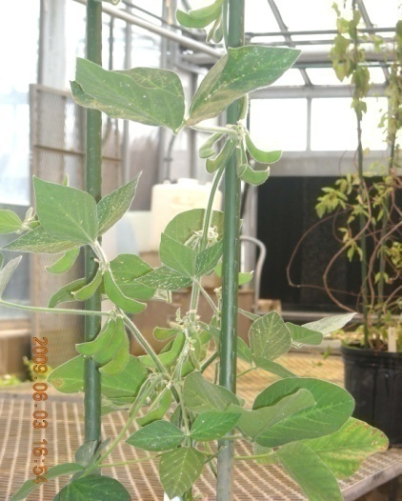
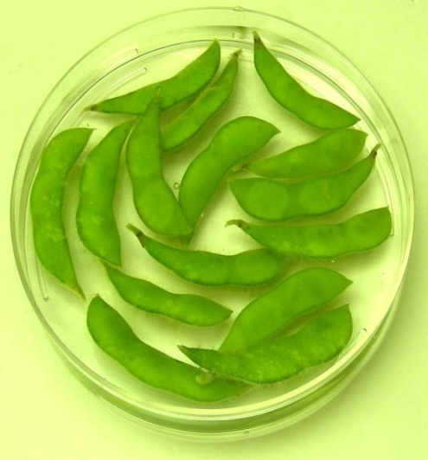
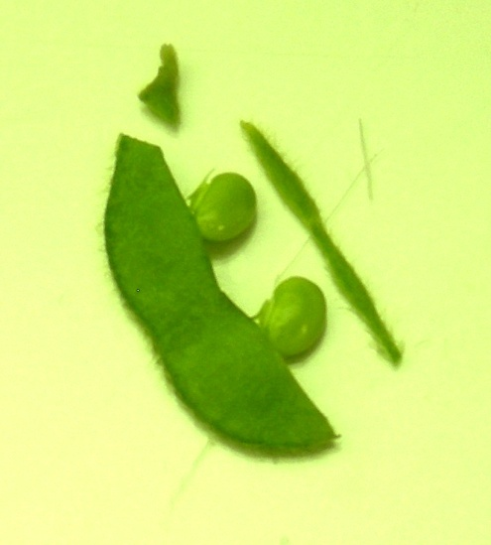
High embryogenic capacity
soybean cv. Jack.
Surface sterilization of the
immature soybean pods
Dissection of the immature pod
for the immature seeds

Slide 4
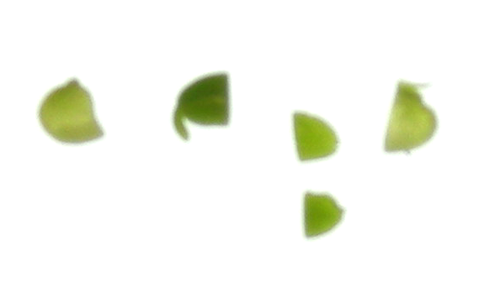
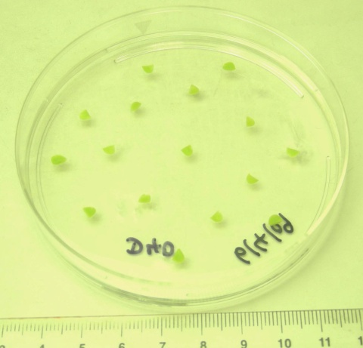
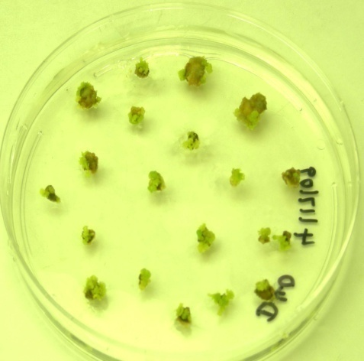
Dissection of the immature seed
and separation of the two
cotyledons from without the
embryonic axis end
Place the cotyledons on D40
(40 mg/L 2,4-D) medium with
the flat side up
Somatic embryo induction after
30 days of the inoculation

Slide 5
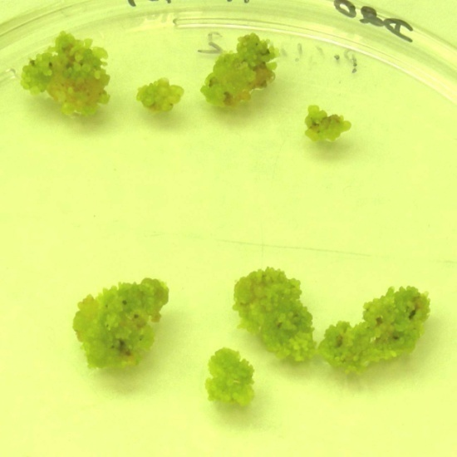
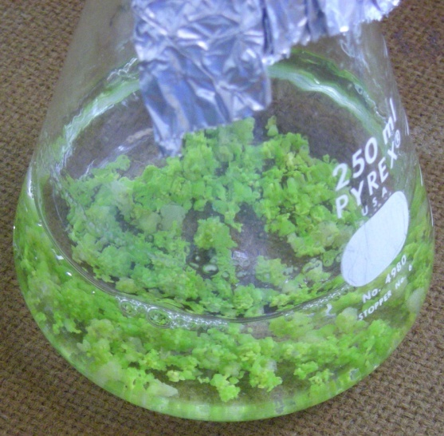
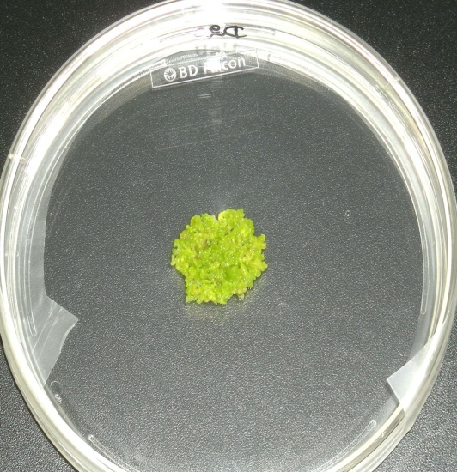
Induced embryos on D40 are
proliferating on D20
(20 mg/L 2,4-D) medium
Globular stage somatic embryos
are transferred from D20 medium
into FN liquid medium
(10 mg/L 2, 4-D)
The small globular stage somatic
embryos cultured in FN liquid
Medium are placed on D20
Medium for bombardment

Slide 6
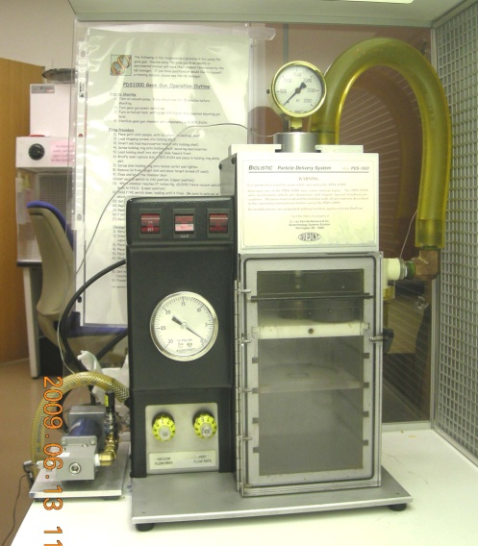
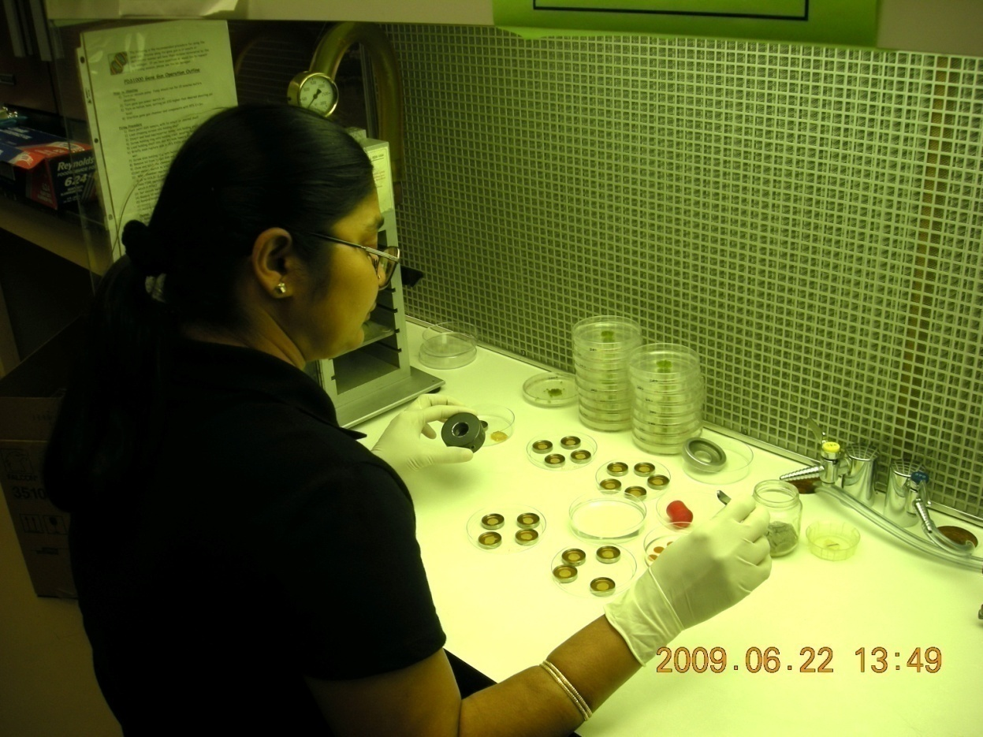
A DuPont Biolistic PDS 1000/HE
Instrument (Gene gun)
A researcher performing the bombardments

Slide 7
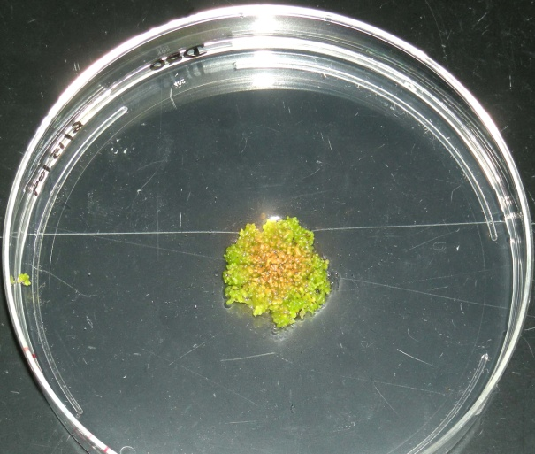
Helium chamber
Rupture disk
Macro carrier
DNA coated gold particle
Stopping screen
Focusing device
Target tissue
Soybean somatic embryo
Cultures before the bombardment
Soybean somatic embryo
Cultures after the bombardment

Slide 8
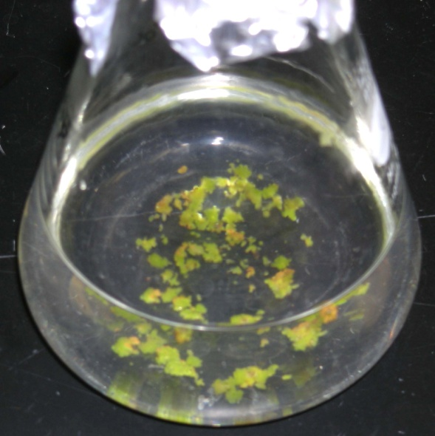
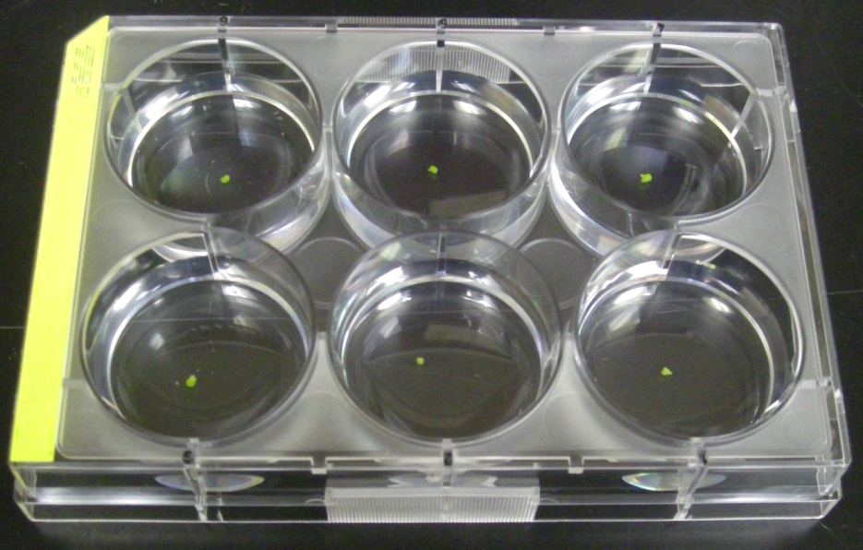
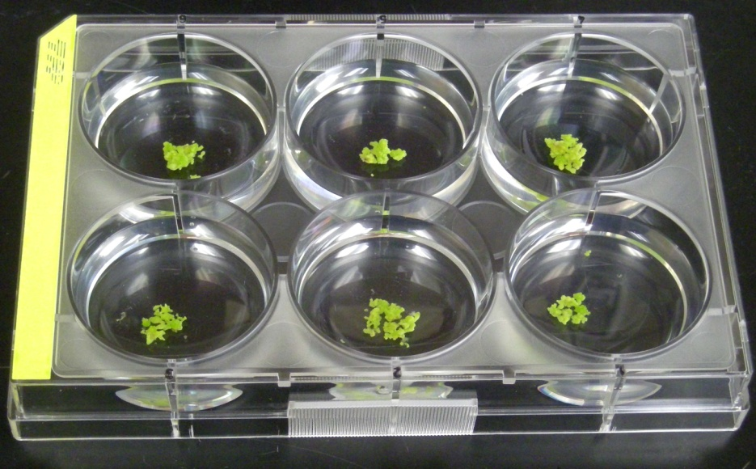
Post bombardment cultures
are in FN lite medium
(5 mg/L 2,4-D) containing
30 mg/L Hygromycin as a
Selectable marker
After post selection, the individual
green transformed embryo is
inoculated in FN lite medium
In a multiwell plate
After 5 weeks , the individual
green transformed embryo
generated the new clonally
propagated transformed
embryogenic suspension cultures

Slide 9
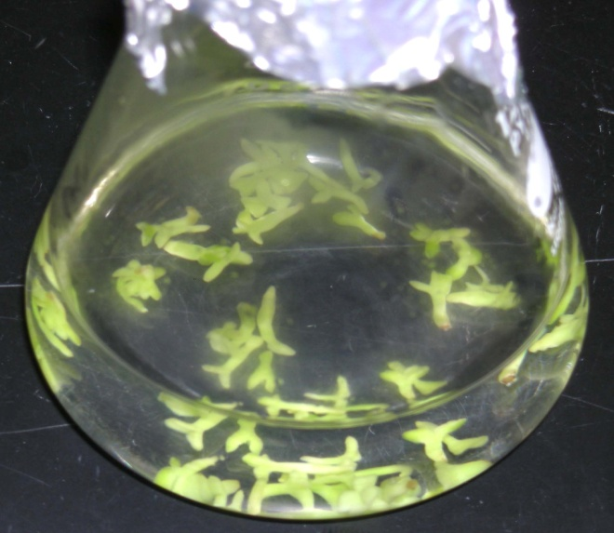
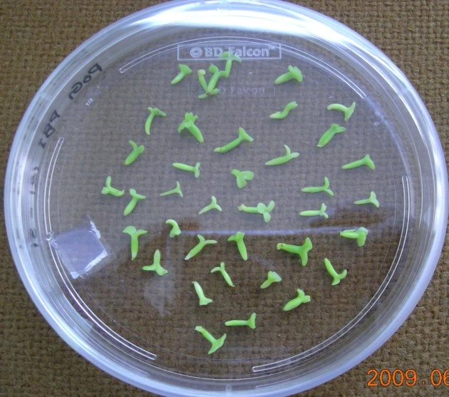
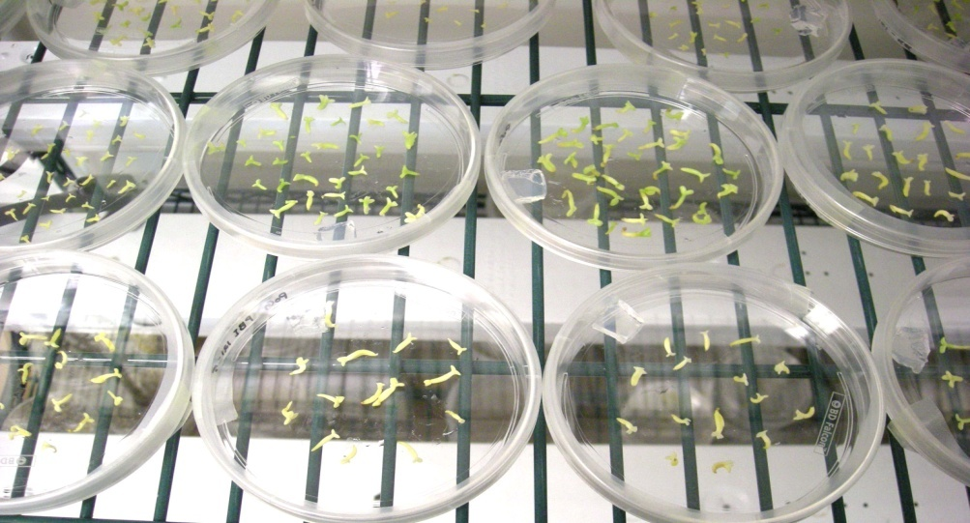
The globular stage embryos
are matured in SHaM (Shoot
Histodifferentiation and
maturation) medium
Desiccating the matured
embryos
After 7 days, the embryos turned
Into cream color during
desiccation process.

Slide 10
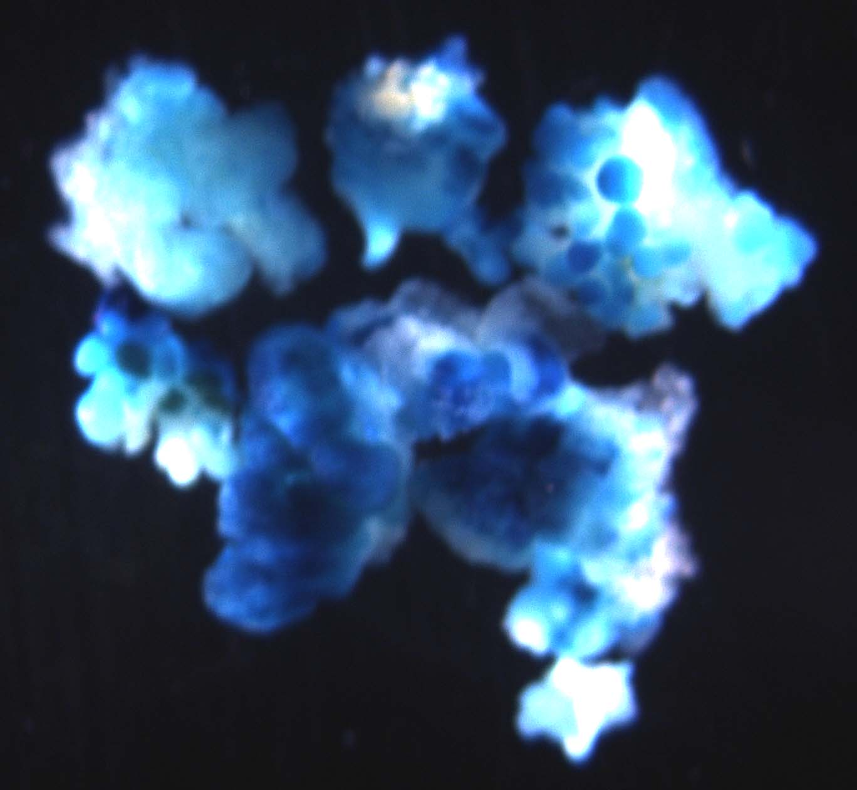
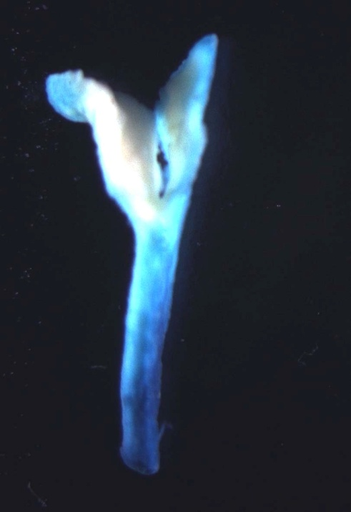
The transformed proliferated
somatic embryos are GUS stained
The transformed matured
embryo is GUS stained

Slide 11
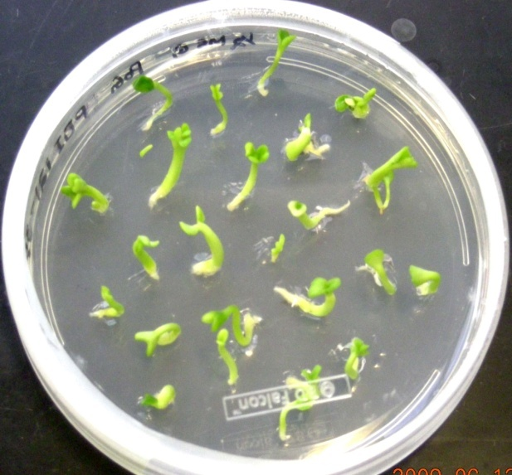
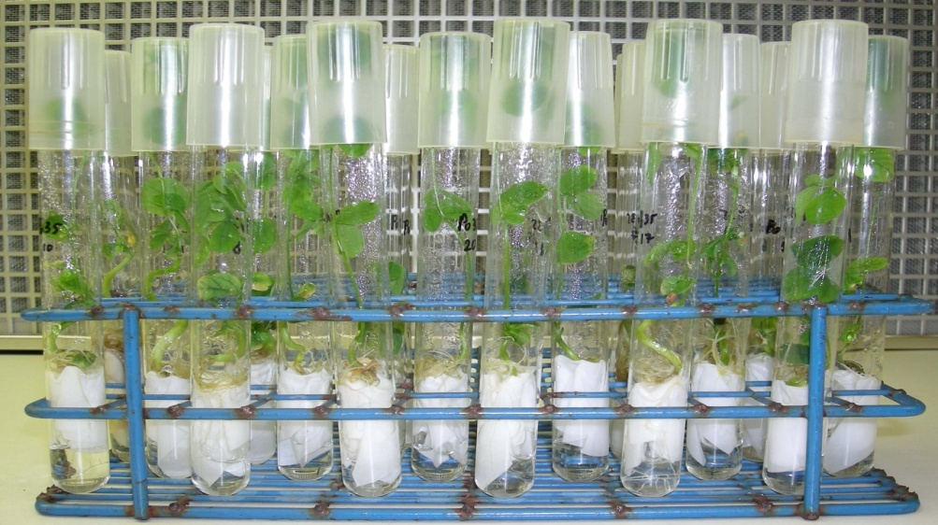
The desiccated embryos are
on the germination medium
After the root formation, these were transferred
onto filter paper bridge in half strength MS medium
for the faster shoot growth

Slide 12
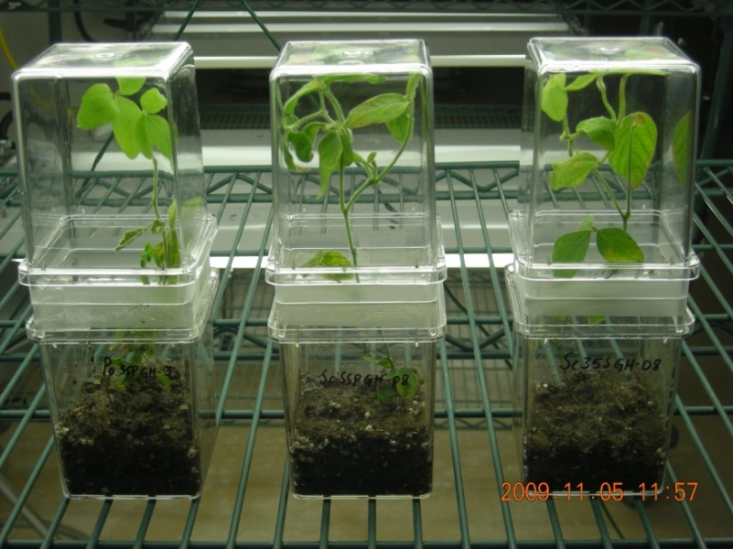
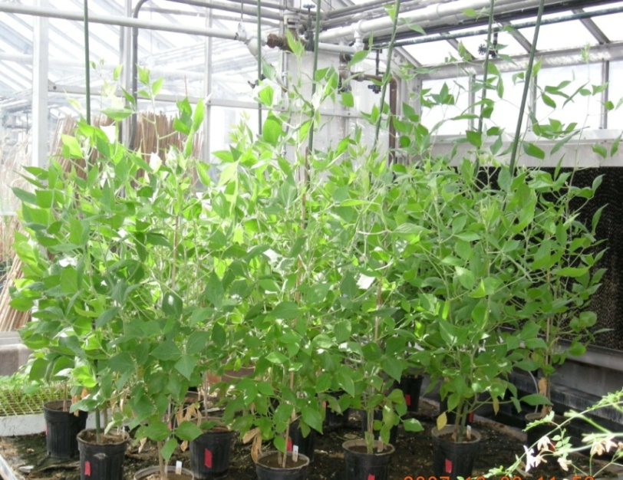
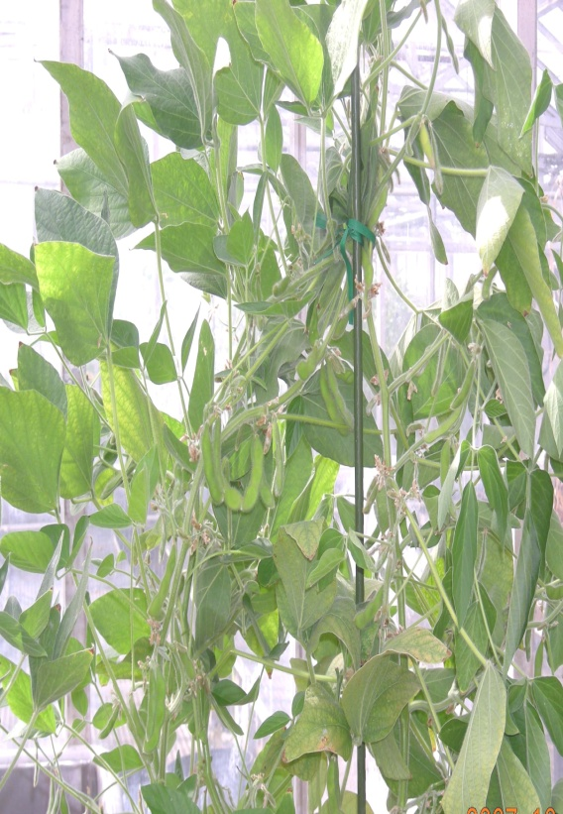
The plants are hardening in magenta boxes at 23:1 photo period to prevent the Premature induction of flowering
The plants are transferred to greenhouse from magenta boxes and at this point the plants are maintained at 16:8 photo period to permit flower and seed set

